Slide 1

How to Deploy Angular Application with

Slide 2
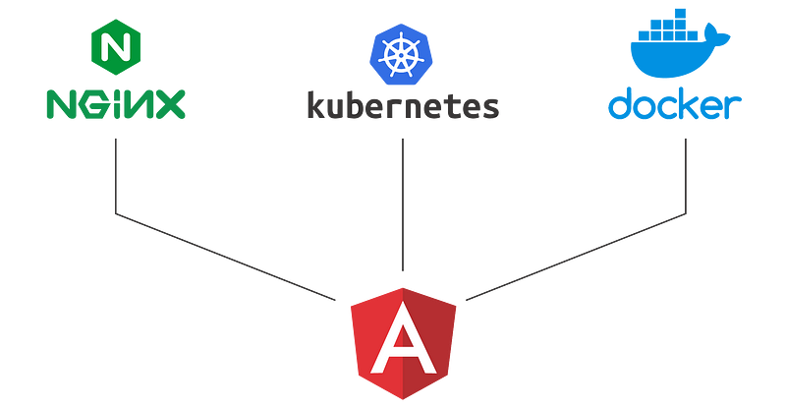
Real world deployment

Slide 3
STEPS
Create Angular project
Build Angular project
Generate deployable artifacts of angular projects
Create server using Express library in Node Js
Run the angular as normal web application

Slide 4
Environment specific configurations
How to make application support multiple instances
production: true,
apiBase: 'http://prod-server:2080/app/',
env: 'prod',

